Slide 1
Exploratory Project
Under: Dr. Amit Kumar Singh
By Team:
Gujulla Leel Srini Rohan,
Akula Hemanth,
Rohit Kumar Gautam.

Slide 2
Hand Gesture Controlled Robot Arm

Slide 3
We had divided the project into 3 parts
Hand Gesture Segmentation and Classification
Robot Assembly and Arduino Control
ROS
Deciding Robot pose according to number on dice

Slide 4
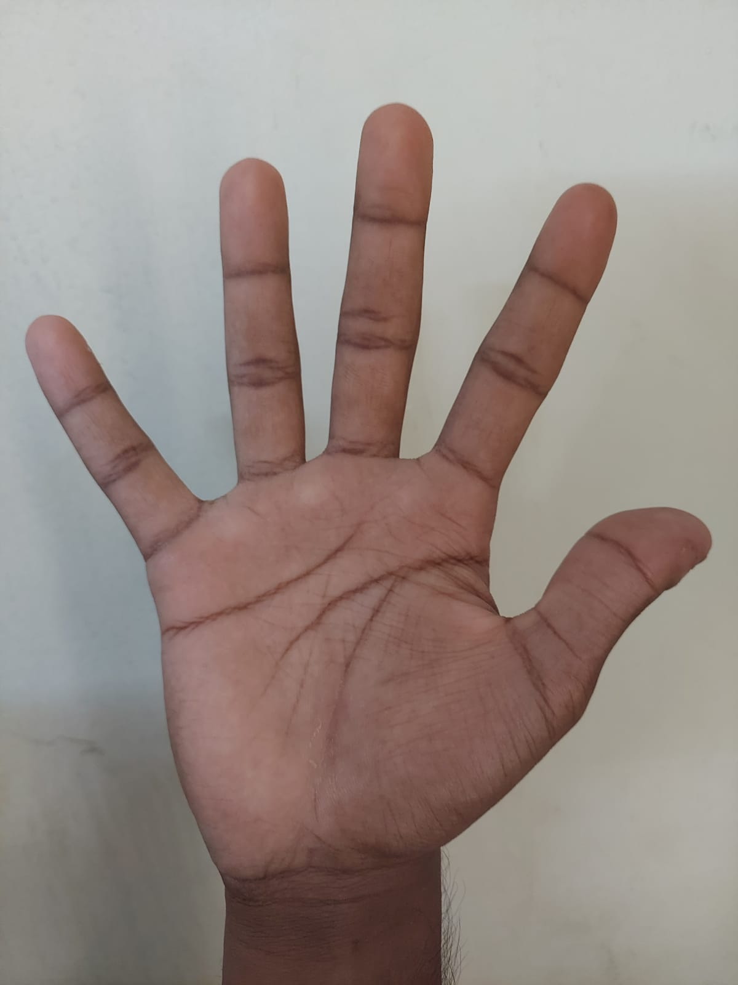
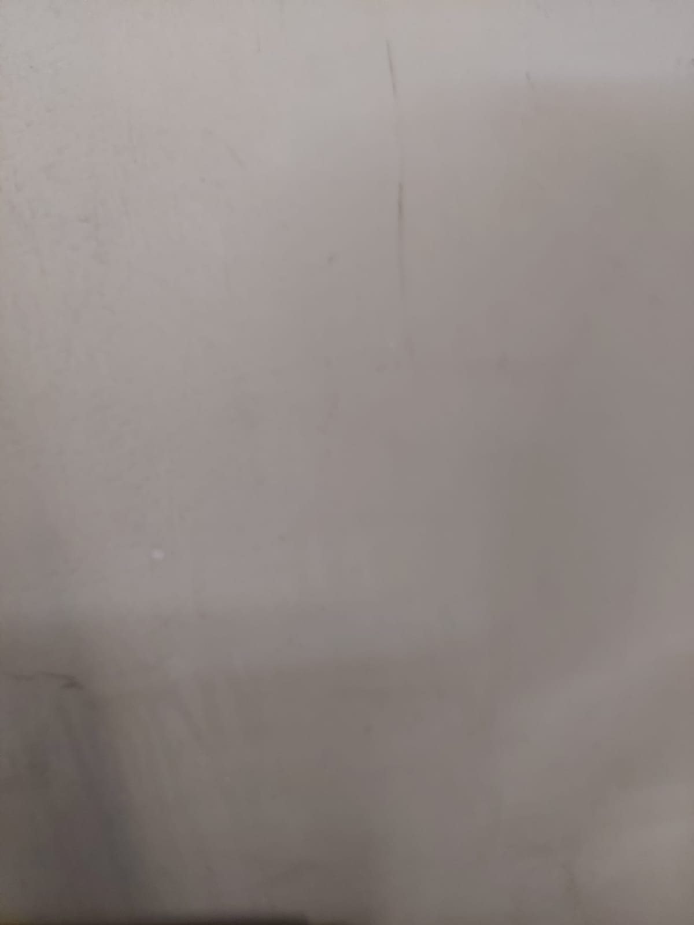
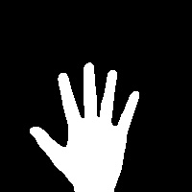
Hand Gesture Segmentation and Classification
Firstly, we have removed background from the hand image by subtracting matrices
=

Slide 5
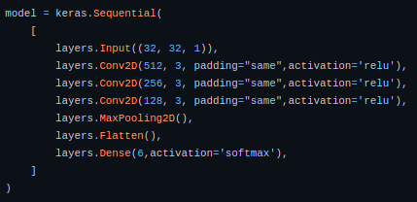
We trained a CNN model using Tensorflow & Keras as framework in python
Input of model is segmented image & output is the type of gesture
Configuration of model is

Slide 6
Dataset Preparation & Training
We made 50 images of each class manually
Using OpenCV we have augmented data making 50 to 500
Trained model for 30 epochs. Obtained an accuracy of 98% on training set and 92% on test set
We have successfully distinguished 3 gestures (Five ,Thumbs Up, Thumbs Down) but failed to classify Super and Fist. Hence we considered Super and Fist as same class

Slide 7
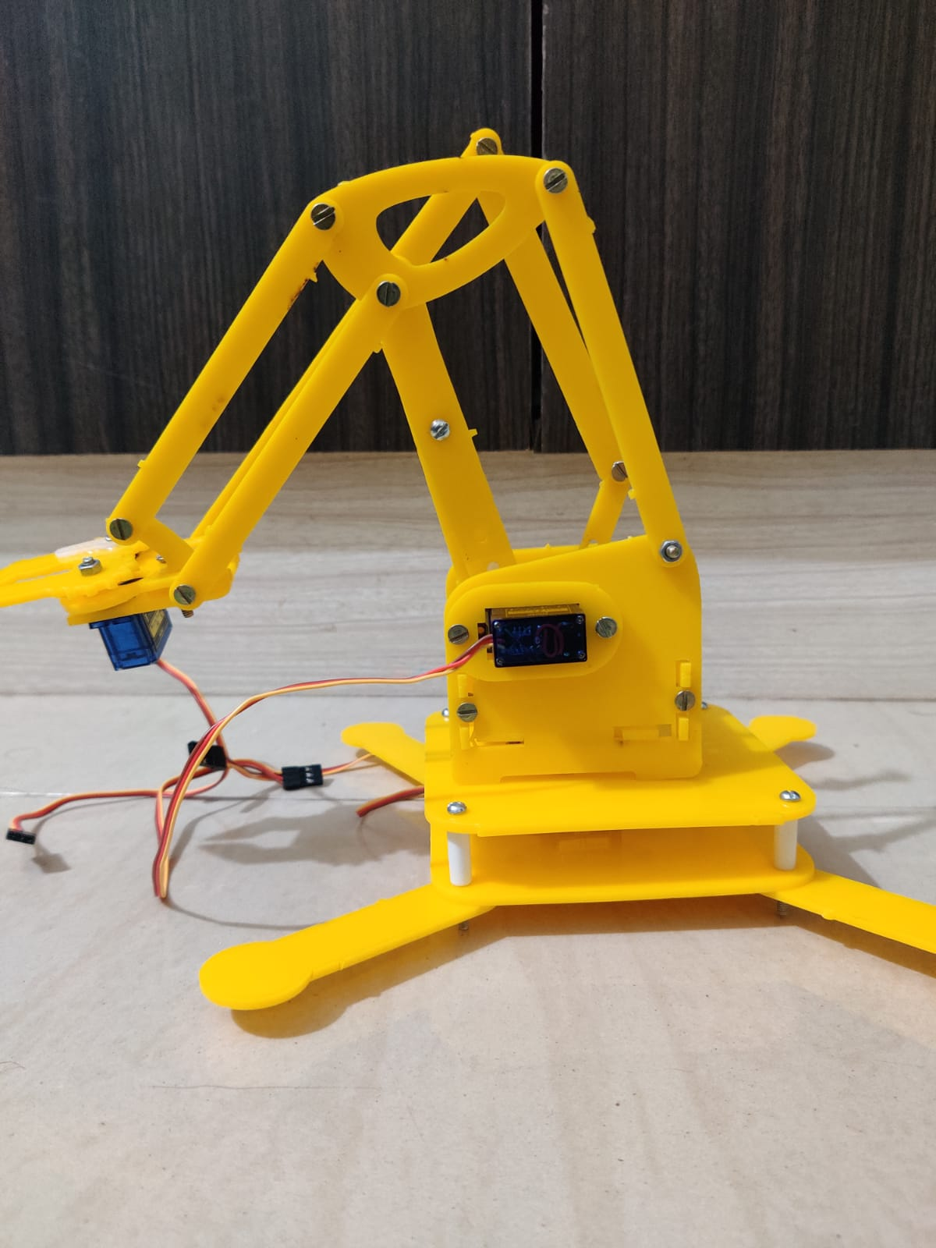
Robot Assembly and Arduino Control
We have assembled the parts given into a 4 DOF robot arm with servo motors to provide necessary degree of freedom
Servo Motors are joined to Servo Shield which is then joined to arduino
Arduino is connected to laptop through B Port cable

Slide 8
ROS and Pyfirmata
We have used Robot Operating System (ROS) to generate path from one pose of robot to another
ROS publishes a topic called joint_states which has information about joint angles in simulator
Using the above topic we have written a piece of code in python to transfer the angles in simulation to servo motor

Slide 9
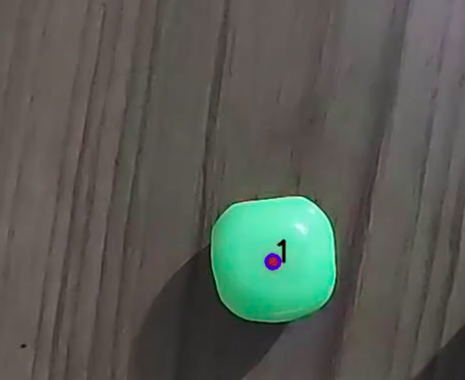
Dice Number Detection
We have written a snippet of code to detect the number on dice using OpenCV’s Simple Blob Detector
According to the number on dice the robot arm calculates the position of joints

Slide 10
According to the number on dice and gesture given the robot arm goes to specific position
There are specific positions for every number on the die .You can control the position of the robot arm with hand gestures. We use 3 gestures
Thumbs Up: Moves the arm to a specific position according to number on dice
Thumbs Down: Moves the arm to initial position
Fist : Closes the gripper

Slide 11


Slide 12
References
https://www.kaggle.com/datasets/aryarishabh/hand-gesture-recognition-dataset
https://pyfirmata.readthedocs.io/en/latest/
https://golsteyn.com/writing/dice
https://moveit.ros.org/
https://www.youtube.com/watch?v=kUHmYKWwuWs

Slide 13
THANK YOU

